Slide 1

Cybersecurity
Lecturer: Dr. Ehab Abousaif
TA: Eng. Youssef Shawky
Team Members:
Khaled Sherif Eissa 221010359
Ahmed Samer 221005991
Muhammed Yasser 221006789
Hazem Mohamed Gamal 221006586

Slide 2
Table of contents
01
02
04
05
03
Introduction
Problem Statement
Methodology
06
Code
Limitations / Challenges
Conclusion

Slide 3
01
Introduction

Slide 4
Types of Ciphering
The project aims to explore and implement classical substitution ciphers. The objectives are to understand the foundational concepts of cryptography, gain hands-on experience in coding encryption and decryption algorithms, and perform a comparative analysis of these techniques in terms of complexity, security, and efficiency.
Types:
Caesar Cipher
Hill Cipher
Playfair Cipher
Vigenere Cipher
Vernam Cipher

Slide 5
Description
Caesar
Hill
Playfair
Shifts each letter in the plaintext by a fixed number of positions down the alphabet.
Employs linear algebra and matrix multiplication to encrypt blocks of letters.
Uses a 5x5 grid of letters to encrypt digraphs (pairs of letters) in the plaintext.
Vernam
Vigenere
Implements a one-time pad for encryption, using a random key equal in length to the plaintext.
Utilizes a repeating keyword to shift letters in the plaintext by varying amounts.

Slide 6

02
Problem Statement

Slide 7
Problem Statement
In the digital age, the security of sensitive information is paramount. While modern encryption methods provide robust security, understanding the foundational cryptographic techniques is essential for developing a comprehensive knowledge of cybersecurity.
Despite the ciphering techniques simplicity, these ciphers offer critical insights into the evolution of encryption and present a valuable educational tool. The challenge lies in accurately implementing these algorithms, analyzing their strengths and vulnerabilities, and comparing their efficiency and security in the context of modern cryptographic needs. To ensure the safety of info and data being used online.

Slide 8
03
Methodology

Slide 9
Methodology into four parts
Research
Algorithm Design
Developing detailed algorithms for the encryption and decryption processes of each cipher.
Ensure that the algorithms are designed to handle typical plain text inputs and produce secure ciphertext outputs
Conduct a thorough review of the historical background and theoretical foundations of the Caesar, Playfair, Hill, Vigenère, and Vernam ciphers.
Study existing implementations and analyses of these ciphers to understand their mechanisms and applications.
Implementation
Testing and Validation
Use a programming language such as Python to code the encryption and decryption functions for each cipher.
Create a user-friendly interface for inputting plaintext, selecting ciphers, and displaying encrypted or decrypted text.
Test each cipher implementation with a variety of plaintext samples to ensure accuracy and functionality.
Validate the outputs against known results and theoretical expectations to verify correctness.

Slide 10
04
Code

Slide 11
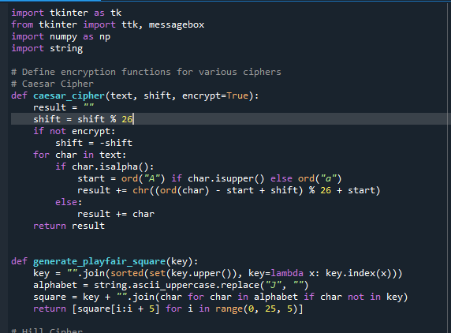
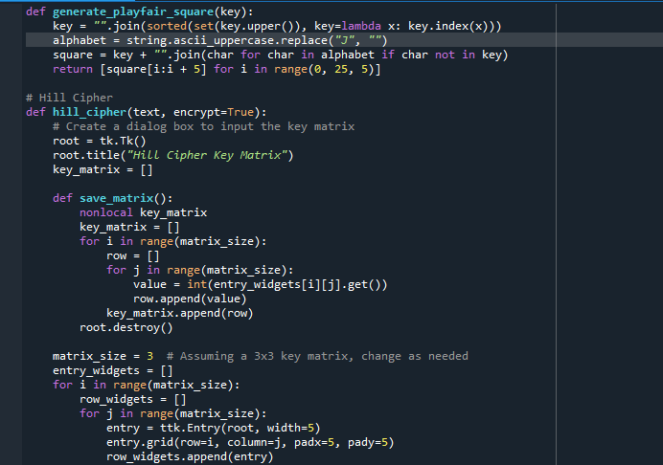
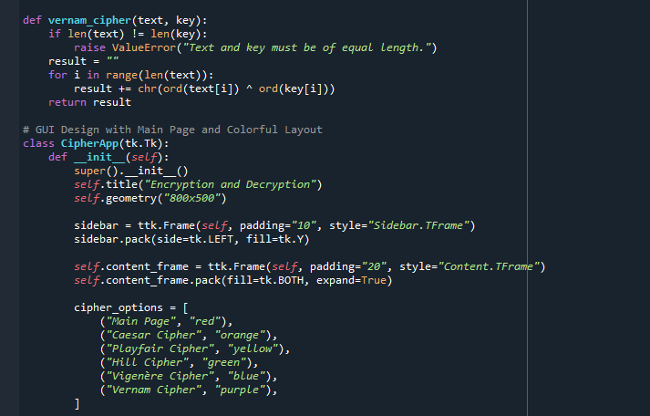
Code

Slide 12
05
Limitations/ Challenges

Slide 13
Limitations Challenges
Classical ciphers are often outdated and not suitable for modern security needs.
Some ciphers, like the Vigenère cipher, suffer from weaknesses in key distribution and management.
Techniques like frequency analysis can easily break ciphers such as the Caesar and Playfair ciphers.
Simple substitution ciphers do not scale well with increasing data sizes and complexity.
Although efficient for small-scale use, classical ciphers are less efficient for large volumes of data compared to modern algorithms.
The security provided by these ciphers is insufficient for protecting sensitive information in today's digital environment.
Ensuring the correct implementation of each encryption and decryption algorithm.
Developing robust methods to handle incorrect inputs and edge cases.
Balancing between simplicity of implementation and computational efficiency.
Accurately comparing different ciphers in terms of performance, security, and complexity.
Making complex cryptographic concepts understandable and accessible through clear documentation and user interface design.
Thoroughly testing the implemented ciphers against potential cryptographic attacks.
Managing computational resources effectively, especially when dealing with more complex ciphers like the Hill cipher.
Creating a user-friendly interface that allows seamless interaction with the encryption and decryption tools.

Slide 14

Thanks!

